Slide 1

Artificial Intelligence for Games Week 1 – History of Game AI Steve Rabin
Please wear a mask in this course.
TAs: Jian Kia Phua, Brandon Hsu, Zak Stephenson, Keaton Sullivan, John Tseng, Andrew Roulst

Slide 2
Questions
How many tests are there in this class?
What is the penalty for turning in a late project?
When are late projects due?
The first time you miss a class, what happens?
If you are late to class, what happens?
How are coding projects checked for copied code?
What is the penalty for copying code?

Slide 3
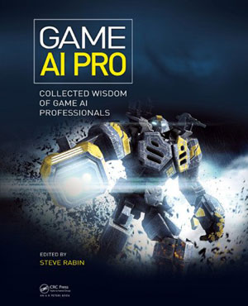
Optional Readings
www.gameaipro.com
GAIP 1, Ch 1: What is Game AI?
GAIP 2, Ch 1: Game AI Appreciation, Revisited
GAIP 1, Ch 5: Structural Architecture
GAIP 1, Ch 9: An Introduction to Utility Theory

Slide 4
Written Assignment due Wed, May 22nd (TURN IT IN OR GET DROPPED)
Step 1:
Watch this 27min GDC talk: “30 Things I Hate About Your Game Pitch”
(https://www.youtube.com/watch?v=4LTtr45y7P0)
Step 2:
Brainstorm a list of “Things I Hate About Your Game AI”.
Research terrible game AI and what people are complaining about. Add to your list.
Use ChatGPT and document all prompts and responses at the end of the doc you turn in.
Step 3:
Decide on 10 to write about. Your title is “10 Things I Hate About Your Game AI”.
Each item needs a descriptive title header, like “Getting shot in the back is not fun”.
Each item must have 4 to 8+ sentences explaining:
1. What is the thing you hate (or your “beef”).
2. Why you hate it.
3. One or more examples from a real game.
4. (optional) Provide a solution.
Note: Points deducted for incomprehensible writing, poor grammar, and/or spelling mistakes.

Slide 5
Homework due next Wed, May 22nd
Turn In
Electronic document in Moodle.
Submit a Word doc (you must use the template).
No late submissions on this HW.

Slide 6
Goals of an AI programmer
Different than academic or defense industry
1. AI must be intelligent, yet purposely flawed
2. AI must have no unintended weaknesses
3. AI must perform within the constraints
4. AI must be configurable by game designers or players
5. AI must not keep the game from shipping
6. AI must be entertaining and challenging

Slide 7

Game AI = human authored behavior
“Human authored behavior is the absolute right answer in this domain.”
“In some ways, I think that we’re not really in the business of building AI, we’re in the business of building domain-specific, highly customizable, carefully constrained programming languages.
What we do is find better ways to enable humans to define how the computer should behave, which is fundamentally what programming is... and we as a community – game AI specifically – have led the charge in that domain for 2-3 decades now, and have made *enormous* strides along the way.
Hell, the military simulation industry is only now figuring out things that we did 10+ years ago (like behavior trees). For instance.”

Slide 8
Insight: Game AI is entertainment
Beating the player is not the goal
The player feeling challenged and having a good time is the goal
The AI doesn’t have to solve the hard problem of intelligence
Cheating is OK
“If you ain’t cheating, you ain’t trying. If you get caught cheating, you ain’t trying hard enough”
The AI needs to give a performance
The AI is like an actor who plays a part and gives a performance
The AI should give (fake) clues so that it is perceived as being more intelligent

Slide 9
A Brief History of Game AI

Slide 10
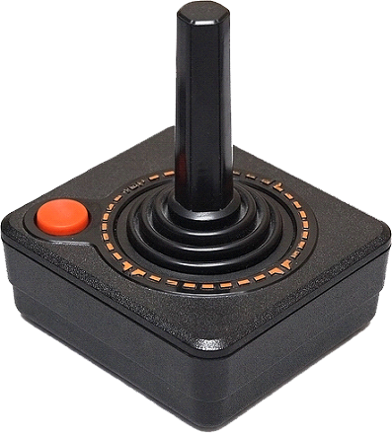
The Past

Slide 11
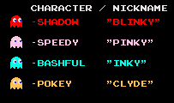

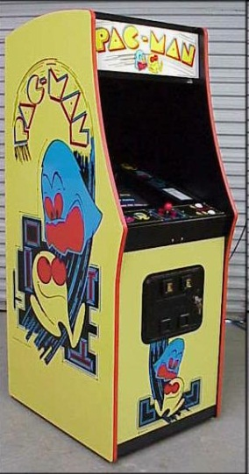
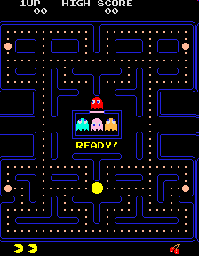
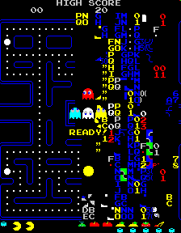
1980
Toru Iwatani, NAMCO
17 months to create
Ghost AI
Blinky chases player
Pinky targets player's future position
Inky chases less directly
Clyde ignores player
Implicit enemy cooperation
Wave-patterned attack, retreat cycle (Meta AI)
No randomness

Slide 12
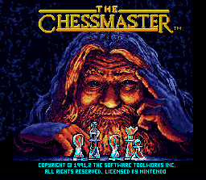
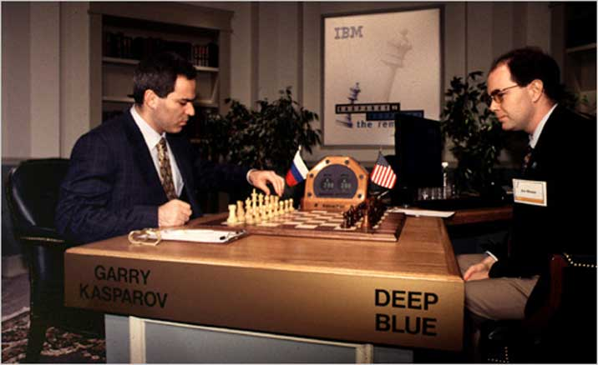
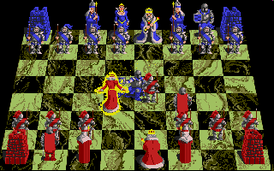
1986
Chess was an early application of “real” AI in games
In 1997, IBM’s Deep Blue defeated a reigning world champion (Garry Kasparov)
After the lost match, Kasparov said that he sometimes saw deep intelligence and creativity in the machine’s moves, which he could not understand.

Slide 13

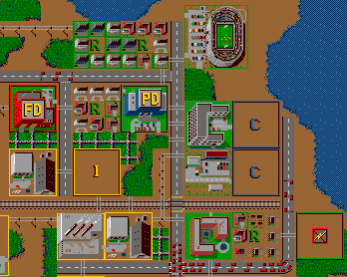
1989
City Simulation
Cellular automata
Influence maps

Slide 14
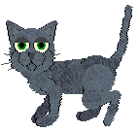







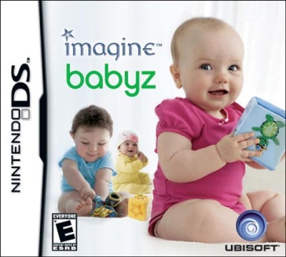
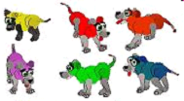
1995
Original virtual pets
Adaptive
Emotional
Memory

Slide 15
Petz (Dogz, Catz)
“The Petz have a simple adaptive AI which pays attention to how much the user likes or dislikes other petz, activities and toys, and modifies its weights and attitudes towards them appropriately. They also remember their history of interaction with the user and can express varying stages of neglected feelings, up to the point where they may “runaway”, our equivalent of death.”
– Andrew Stern, PF Magic

Slide 16
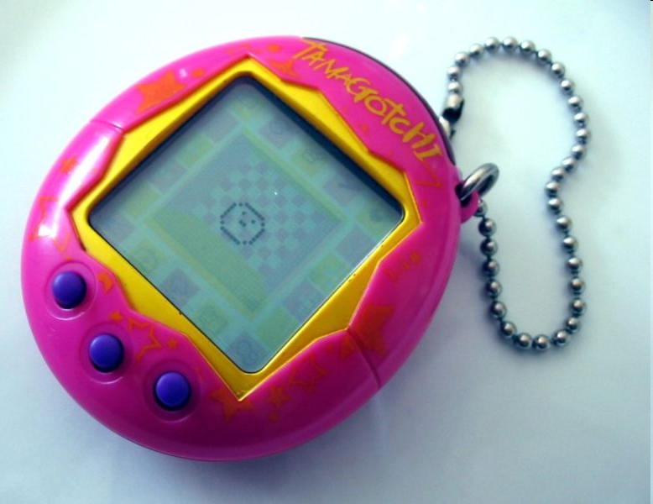





1996
Taking care of virtual creature
Feed
Play games
Clean up waste
Check hunger, health, happiness
Very needy
Certain versions can starve or die in less than half a day from lack of care

Slide 17
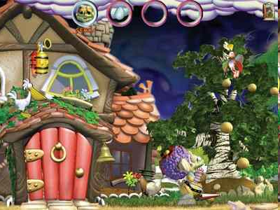
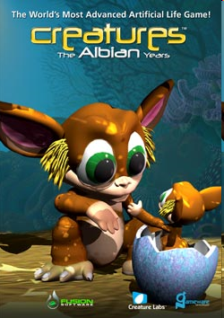
1996
Breakthrough in Alife
First popular application of machine learning in a game
Neural networks for behavior
(1000 neurons in 9 lobes with ~5000 synapses)
Genetic algorithms to evolve and breed new creatures at runtime
Player has role as teacher (positive and negative rewards)

Slide 18


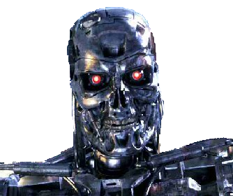
The appeal of needy AI
Clive Thompson – Wired.com
“I think the appeal is much subtler—and weirder. If we love Nintendogs, it's not merely because they're so adorable. It’s that they’re so needy... The thing is, this precisely inverts the normal logic of artificial intelligence.
Back in the '70s, everyone assumed we'd eventually have super-smart robots as servants—guarding our homes, managing our schedules and bringing us a beer. That never happened. Nobody really wanted robots like that, because robots like that are kind of scary. Nobody wants a Terminator hanging around the kitchen.”

Slide 19
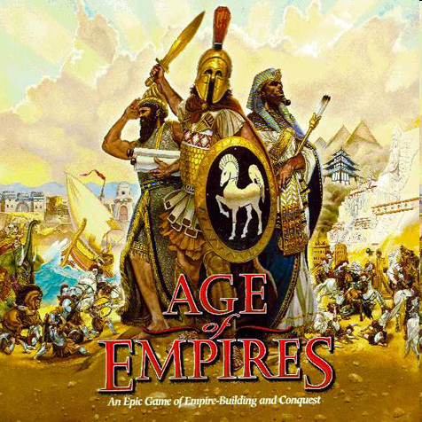
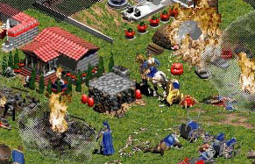
1997
Remembers where you attacked, favorite units, etc.
Uses a playbook as a template for the AI
Scriptable through ASCII file
“We also let the CPs remember your general playing tendencies so that they can improve playing against you in the randomly generated games. This has helped the quality of the AI out a lot. Well enough, in fact, that we’ll be able to ship the game with an AI that doesn’t cheat.”
– David Pottinger, Ensemble Studios

Slide 20
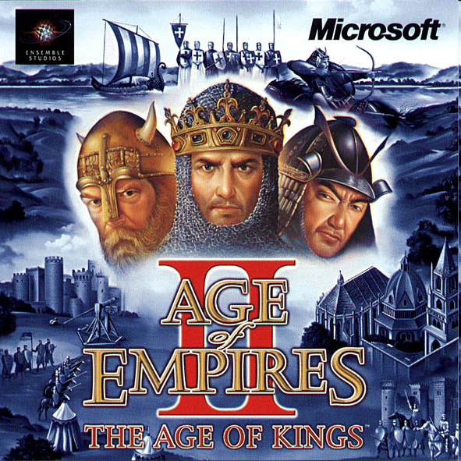
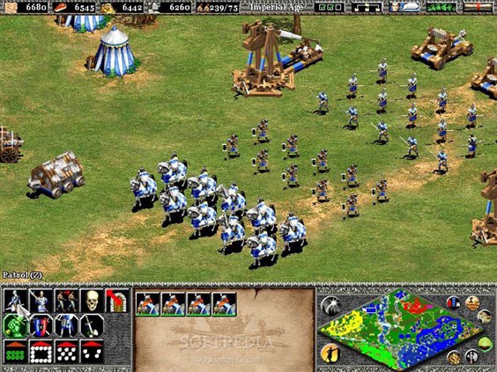
1999
Formations were innovative and dynamic
Could split and rejoin
Explored what could be done with large formations
Dave Pottinger
Wrote a series of pathfinding articles for Game Developer magazine detailing the pathfinding and formations

Slide 21

1998
EA Press Release:
Madden NFL 98 Technology Advancements
Madden NFL 98 pushes interactive sports game technology to a new level. A key area of focus this year was devoted to the game’s artificial intelligence (AI), which is the manner in which the computer reacts as the game is played.
Pioneered by EA SPORTS, Madden NFL 98 is the first video game to implement a concept called Liquid AI™. Just as a liquid, such as water, flows when it hits a surface to fill open space and gaps, Liquid AI enables the video football players in Madden NFL 98 to dynamically flow and move to the correct positions on the field in order to make a play.
Other football games will give a player a pre-set responsibility for a play. In Madden NFL 98, however, a player will read a play as it develops, check what other players on his team and the opposing team are doing, and will react and change his assignment if necessary. The game reacts exactly as a human would.

Slide 22
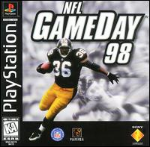
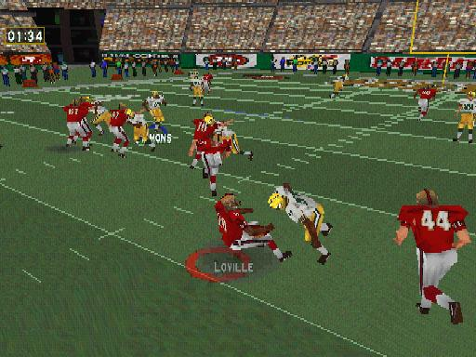
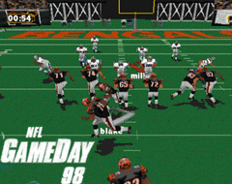

1998
Kelly Flock, president 989 Studios, Sony
Next Generation magazine interview:
“Liquid AI is the stuff that ran down EA’s leg when they saw GameDay.”
– Kelly Flock

Slide 23

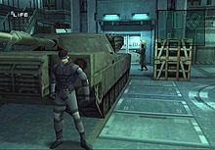
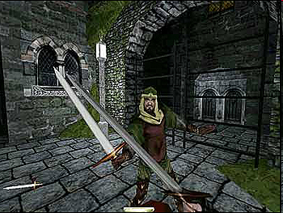

1998
Guards see and hear realistically
Player can hide in darkness and distract with noises
However, Metal Gear was the first stealth game to use light and sound as a game mechanic

Slide 24
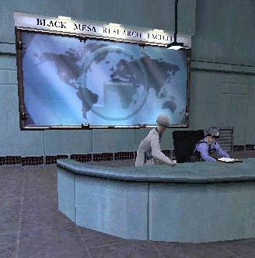
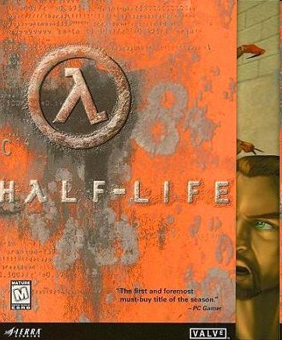
1998
Players praised the AI
AI extremely well integrated into storyline
Heavy use of scripting
Hints placed by level-designers
Monsters get reinforcements if losing
Interactive cut-scenes
“Giving game designers the ability to direct the AI—or give hints or suggestions to the AI—is a really powerful tool. We used a variety of techniques to pull off the AI in Half-Life including designer input; it’s an important tool for filling in the gaps in an AI character's knowledge of the environment or situation. Allowing the designers to add context to AI decisions can make the game much more convincing and rich.”
–Jay Stelley, Valve

Slide 25
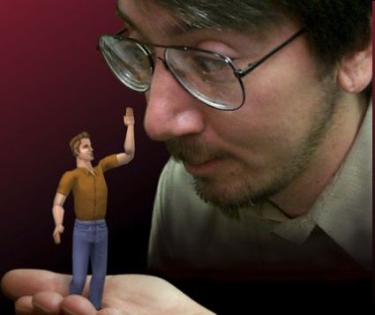


2000
Sims have basic desires and personalities
Emotions between characters
Smart terrain and smart objects
Similar to affordances

Slide 26
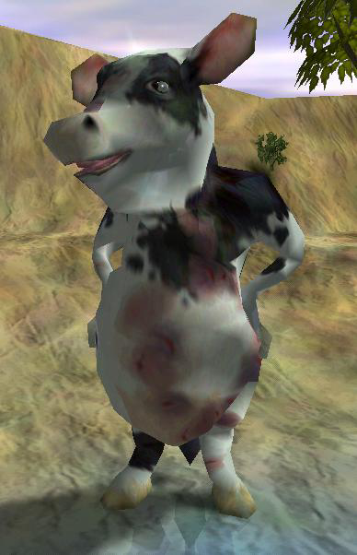



2001
Train your own creature
Reward & Punish
Perceptrons
Decision Tree learning
“Empathy learning”
Gesture recognition
Richard Evans
Detailed in
AI Wisdom 1

Slide 27
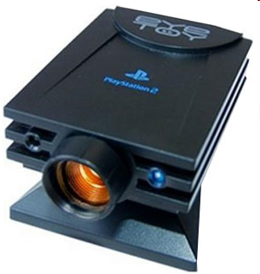
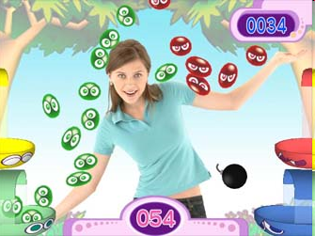
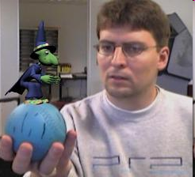
2003
Sold millions
Dr. Richard Marks (Sony)
Gesture recognition / Head tracking

Slide 28

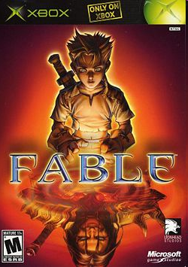

2004
Player reputations
Global and per villager
Villagers recognize your personality and achievements
Adam Russell
Detailed in AI Wisdom 3

Slide 29
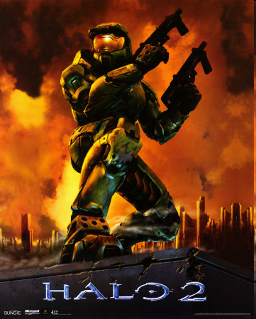
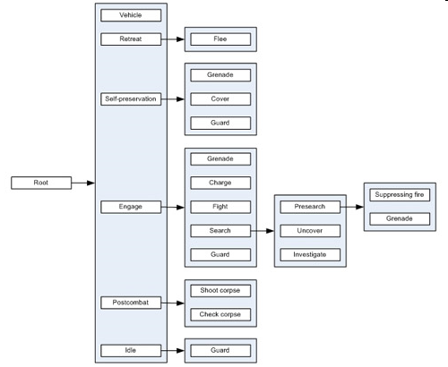

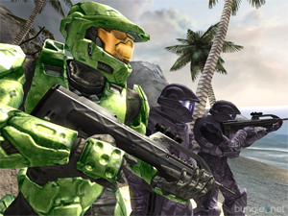
2004
Extremely well-received AI
Drove adoption of Behavior Trees

Slide 30

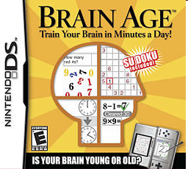

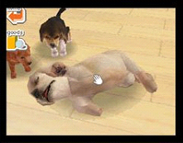
2005
Nintendogs
Speech recognition records and generalizes
Works in any language
Brain Age
Successful non-learning speech recognition game

Slide 31
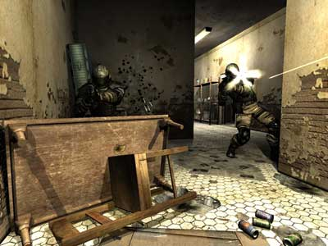


2005
Planning system similar to STRIPS
Inspired many others to experiment with planners
Procedural vs. Declarative
Enemies use the environment
Crash through windows, tip furniture for cover

Slide 32
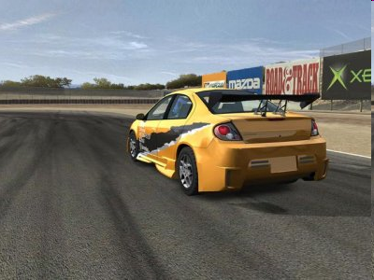

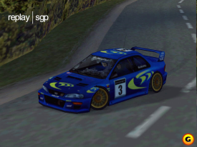
2005
AI drivers trained with Drivatar system
Neural networks are trained to steer and accelerate based on player driving
Players could train their own
Shipped with cars trained by designers
Result of years of research
Machine Learning and Perception group at Microsoft Research in Cambridge, UK
Colin McRae 2.0 (2001)
Neural net drivers

Slide 33

2005
Interactive story
Natural language processing
“By design, Grace and Trip are self-absorbed, allowing them to occasionally believably ignore unrecognized or unhandleable player actions”
Inspired others to attempt dynamic narratives
Far Cry 2 (2008)
Left 4 Dead (2008)

Slide 34
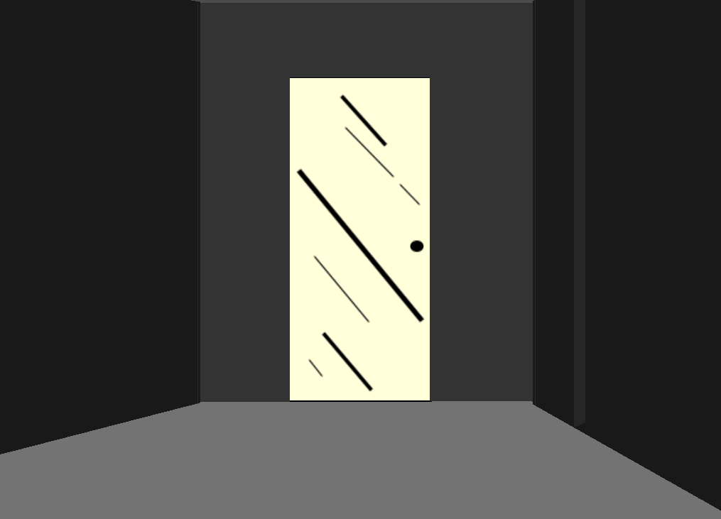

Slide 35
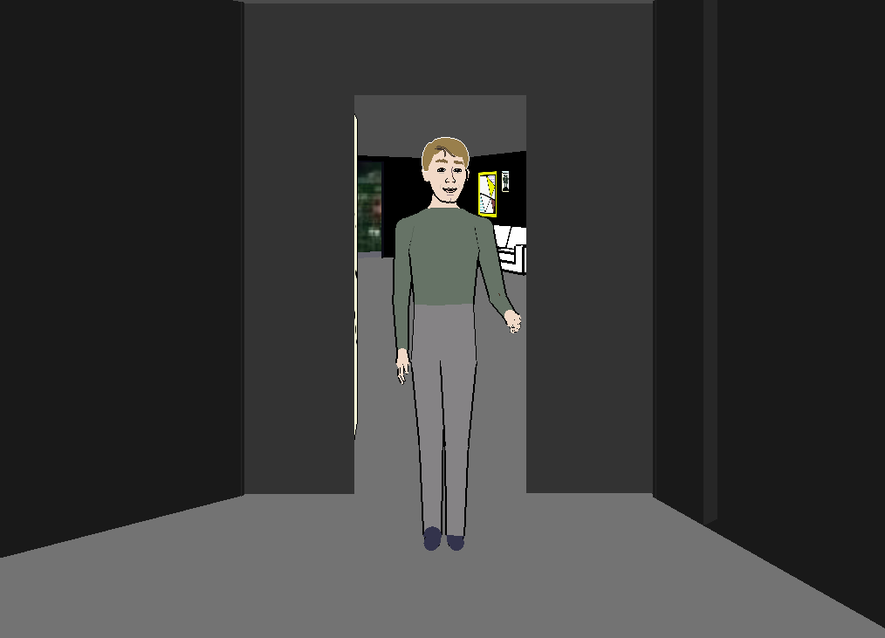

Slide 36
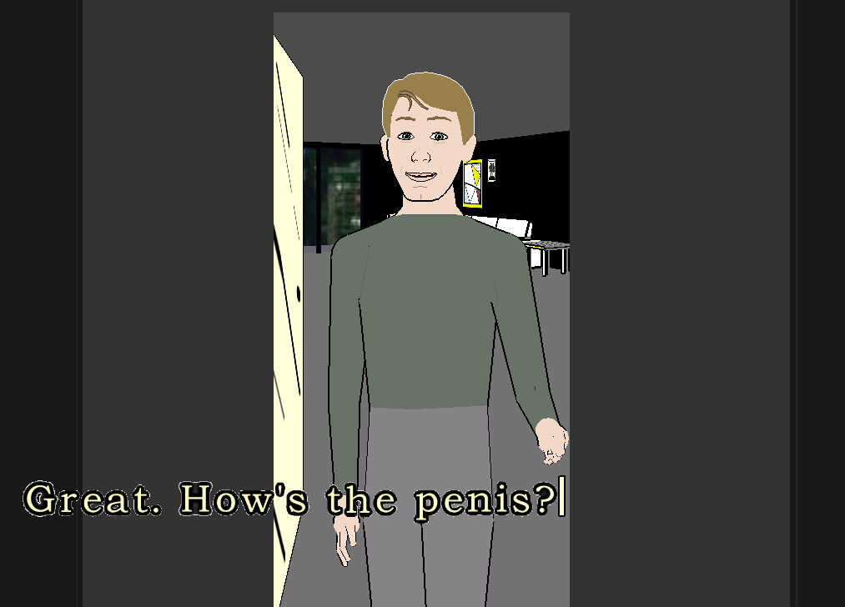

Slide 37
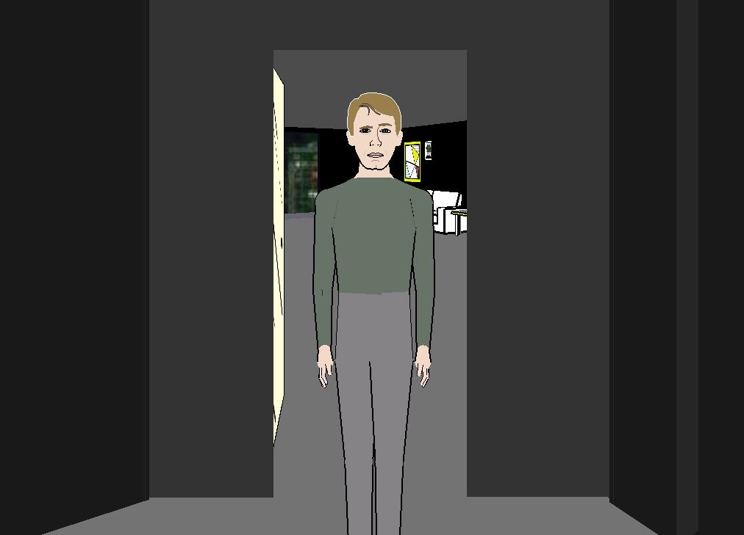

Slide 38
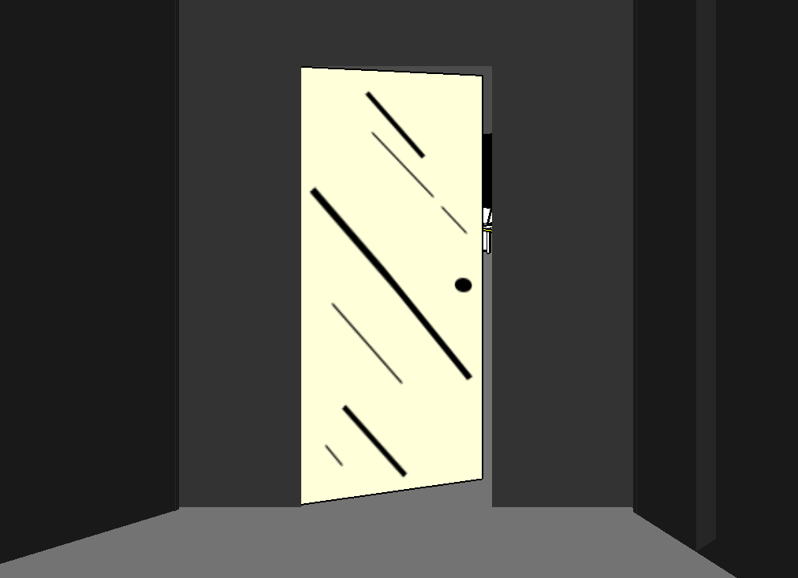

Slide 39
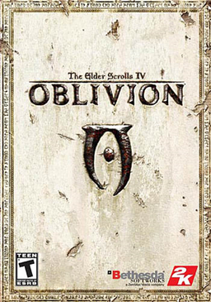
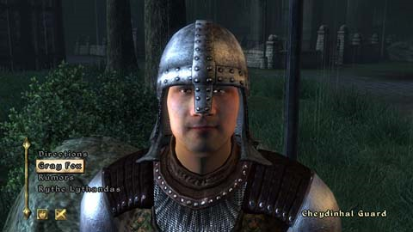
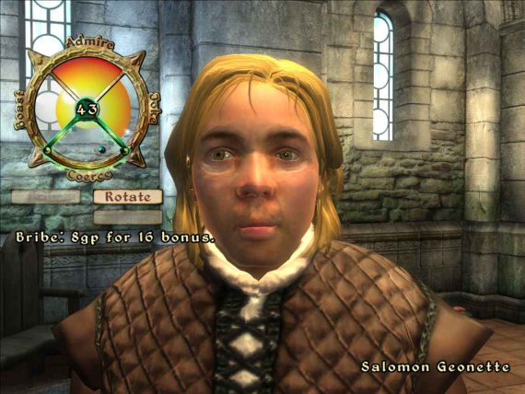

2006
“Radiant AI”
24/7 characters with agendas and routines

Slide 40




2006 & 2009
Gesture recognition
Wii Sports
AILive’s LiveMove
MotionPlus
Physically based 1:1 motion
Ships with WiiSport Resort in 2009

Slide 41



2008
Living cities
Pedestrians, cars, police
Animation
Natural Motion's Euphoria engine
Combines AI, bio mechanics, and physics

Slide 42



2008
Creature Creator does the right thing when manipulating
Dynamically skins and animates creatures

Slide 43


2008
AI “Director” creates a new experience each time
Places enemies based upon each player’s current situation, status, skill and location
The AI Director creates mood and tension with emotional cues
Visual effects
Dynamic music
Character communication

Slide 44



2010
Depth camera creates depth point cloud
Estimates player’s bone positions
20 joints (even when not visible)

Slide 45


2013
Buddy AI

Slide 46

2014
Nemesis System
Procedurally generated
Grunts promoted to Captain and remember you
“Behind-the-scenes soap opera that makes every game of Shadow of War you play unique”

Slide 47



2016
No Man’s Sky
Procedurally generated worlds, creatures, and ships.

Slide 48


2018
RimWorld
The game is an AI-powered “story generator,” where the game is used as the medium for players to experience narrative adventures.
In-game events are procedurally generated by an AI storyteller, which is central to gameplay; game difficulty, event difficulty and difficulty progression depend on its settings.

Slide 49


2019
AI Dungeon
Open-ended storylines using LLMs (Large Language Models, specifically GPT-2, GPT-3)
After beginning an adventure, there are three main interaction methods that can be chosen for each of the player's pieces of text input:
Do: Must be followed by a verb, allowing the player to perform an action.
Say: Must be followed by dialog sentences, allowing players to communicate with other characters.
Story: Can be followed by sentences describing something that happens to progress the story, or that players want the AI to know for future events.
The game's artificial intelligence allows it to adapt and respond to almost any action entered by the player.
Providing blank input can also be used to prompt the AI to generate further content, and the game also provides players with options to undo/redo or modify recent events, in order to improve the game's narrative. Players are also given an option to explicitly tell the AI what elements to "remember" for reference in future parts of their playthrough.

Slide 50

The Present
Suggestions?

Slide 51
Optional Readings
www.gameaipro.com
GAIP 1, Ch 1: What is Game AI?
GAIP 2, Ch 1: Game AI Appreciation, Revisited
GAIP 1, Ch 5: Structural Architecture
GAIP 1, Ch 9: An Introduction to Utility Theory

Slide 52
Written Assignment due Wed, May 22nd (TURN IT IN OR GET DROPPED)
Step 1:
Watch this 27min GDC talk: “30 Things I Hate About Your Game Pitch”
(https://www.youtube.com/watch?v=4LTtr45y7P0)
Step 2:
Brainstorm a list of “Things I Hate About Your Game AI”.
Research terrible game AI and what people are complaining about. Add to your list.
Use ChatGPT and document all prompts and responses at the end of the doc you turn in.
Step 3:
Decide on 10 to write about. Your title is “10 Things I Hate About Your Game AI”.
Each item needs a descriptive title header, like “Getting shot in the back is not fun”.
Each item must have 4 to 8+ sentences explaining:
1. What is the thing you hate (or your “beef”).
2. Why you hate it.
3. One or more examples from a real game.
4. (optional) Provide a solution.
Note: Points deducted for incomprehensible writing, poor grammar, and/or spelling mistakes.

Slide 53
Homework due next Wed, May 22nd
Turn In
Electronic document in Moodle.
Submit a Word doc (you must use the template).
No late submissions on this HW.

